Slide 1
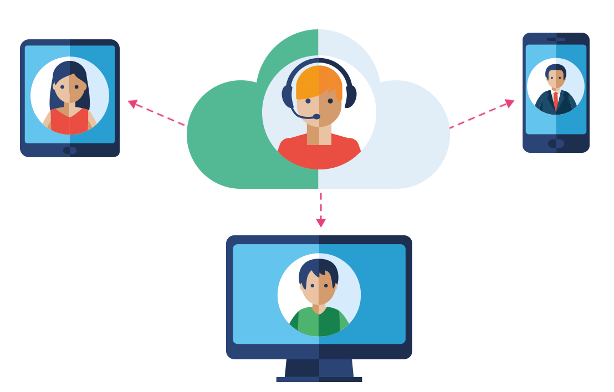
Online Conference Platform

Slide 2

BNN College bhiwandi
Guided by:
Prof. Bhavna Sagar Patil
Presented by:
Gupta Arun Raju
Roll no:35

Slide 3
Abstract
The main aim of the project was to develop a website which would facilitate the online video conferencing of multiple people on same website in real time
This platform will be feature rich and it save time of lot of people allow peoples to communicate the and chat
Person can share their screen in real time
Share file directly to other users

Slide 4
Introduction
The COVID-19 pandemic has led to a significant increase in remote work and online communication. As a result, the demand for video conferencing tools has surged, and businesses, organizations, and individuals are relying on them more than ever before. This project aims to address the need for a reliable and secure video conferencing platform that can support multiple participants.
The video conferencing website will provide users with a seamless and efficient communication platform, accessible from anywhere in the world. The website will be designed to be user-friendly and easy to use, requiring minimal technical expertise to operate. The website will be scalable to accommodate a growing number of users and participants.

Slide 5
objective
Develop a reliable and secure video conferencing solution that can support multiple participants.
Provide high-quality video and audio capabilities to ensure clear and effective communication.
Ensure the platform is user-friendly and easy to use, requiring minimal technical expertise to operate.
Ensure the platform is scalable to support an increasing number of users and participants.
Integrate features such as screen sharing, file sharing, and chat functionality to enhance collaboration.

Slide 6
Project scope:
Design and development of the video conferencing platform.
Integration of audio and video capabilities to ensure high-quality communication.
Integration of security features to ensure the platform is secure from unauthorized access and hacking.
Integration of features such as screen sharing, file sharing, and chat functionality.
Testing and debugging of the platform to ensure it is reliable and user-friendly.
Deployment of the platform on cloud infrastructure to ensure scalability.

Slide 7
Deliverables:
A functional video conferencing platform that supports multiple participants.
High-quality video and audio capabilities to ensure clear and effective communication.
Security features to ensure the platform is secure from unauthorized access and hacking.
Features such as screen sharing, file sharing, and chat functionality.
Testing and debugging reports.
Documentation, including user manuals and technical documentation.

Slide 8
Timeline
The project is expected to be completed within six months from the start of the development phase. The timeline for the project is as follows:
Design and development phase: 3 months
Testing and debugging phase: 1 week
Deployment phase: 1 day
Documentation phase: 4 days

Slide 9
Technologies
Socket io
Express
Node server
Html , CSS , JavaScript
WebRTC
Visual Studio Code

Slide 10
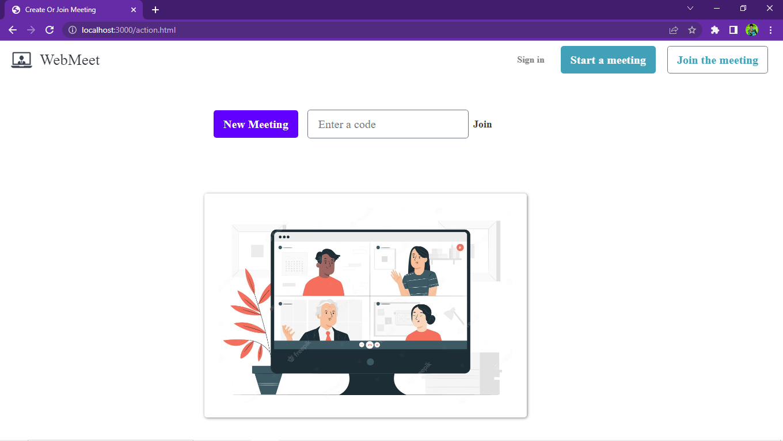

Slide 11
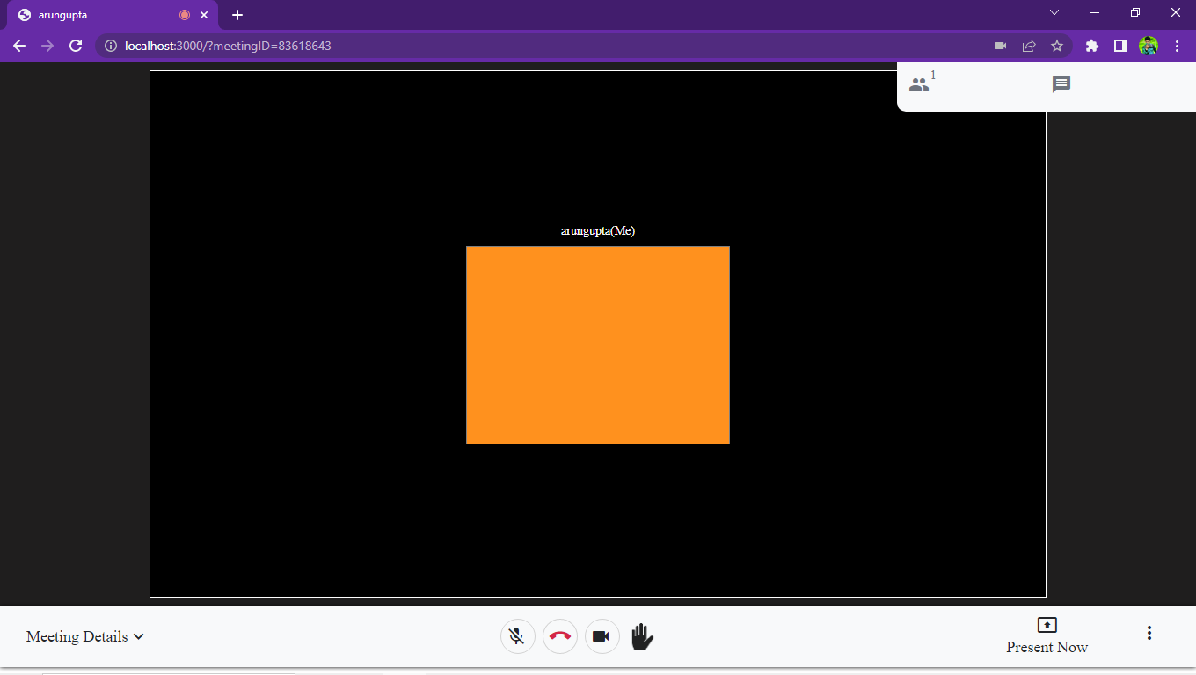

Slide 12
Conclusion:
The video conferencing project aims to provide a reliable and secure communication platform for businesses, organizations, and individuals to hold virtual meetings, seminars, and conferences. The project will focus on developing a robust video conferencing solution that can support multiple participants with high-quality video and audio capabilities. The project scope includes designing and developing the platform, integrating audio and video capabilities, integrating security features, testing and debugging the platform, and deploying the platform on cloud infrastructure. The project is expected to be completed within six months.

